Slide 1

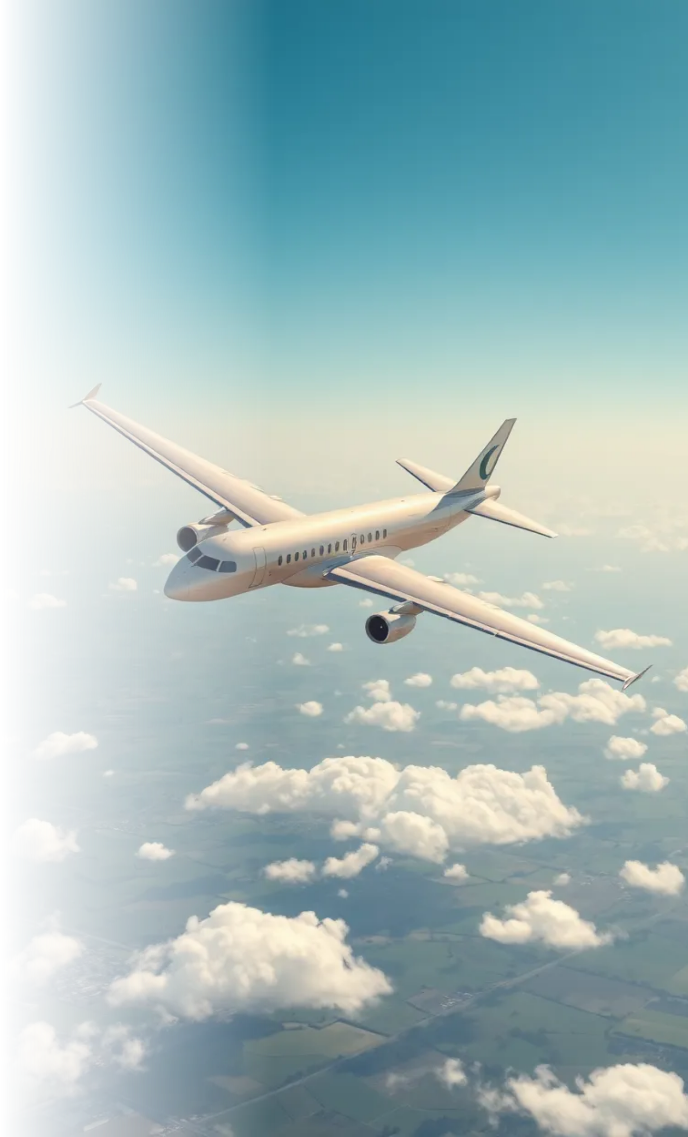
The Journey of Air Flight
This project consists of building data dashboards for visual representation using Tableau.
-the goal of the dashboards are to visualize which airlines have the most delays and potential causes. This information could potentially be useful in the improvement and optimization of airlines, which could improve their branding, customer experience/satisfaction
. This presentation will guide data analysts through the story of aviation, highlighting key data insights, cleaning processes, visualizations, and conclusions drawn from the analysis

Slide 2



Description Data
The data is from 2015 for major airlines and airports in USA
Flight schedules and Origin ,Destination
airport
Reasons of delay
cancellations, diverted, and destinations of trips

Slide 3



Data Cleaning Steps
Step 1: Inspect the Data
Step 2 : Handling Missing Values:
Use Calculated Fields to replace missing values with defaults
Example: Replace missing DEPARTURE_DELAY with 0:
Review Columns
Check the data types of each column (e.g., string, number
.
IF ISNULL([DEPARTURE_DELAY]) THEN 0 ELSE [DEPARTURE_DELAY] END

Slide 4


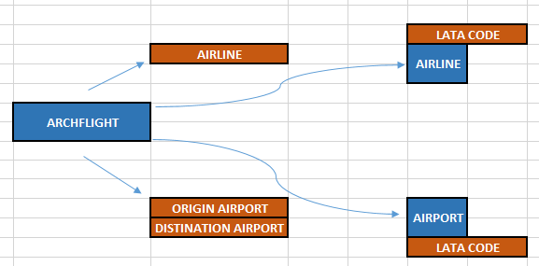
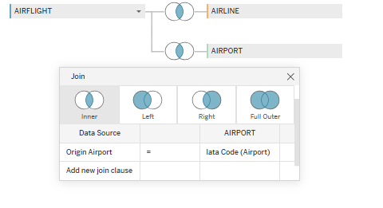
Data Cleaning Steps
Step 3: Calculate New Metrics:
Use Calculated Fields to create new columns:
Total Delay:
[DEPARTURE_DELAY]+[ARRIVAL_DELAY]
Step 4:
JOIN
.

Slide 5

Data Cleaning Steps
Step 5: USING EXCEL
.

Slide 6
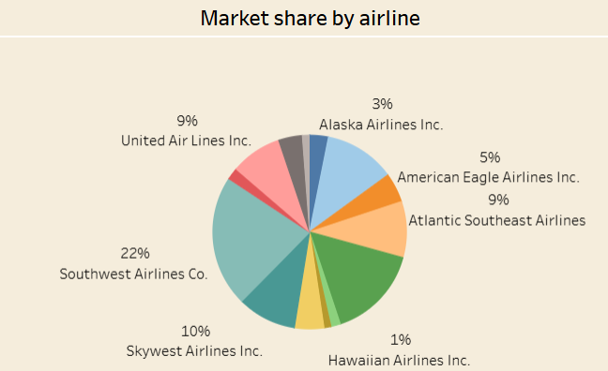
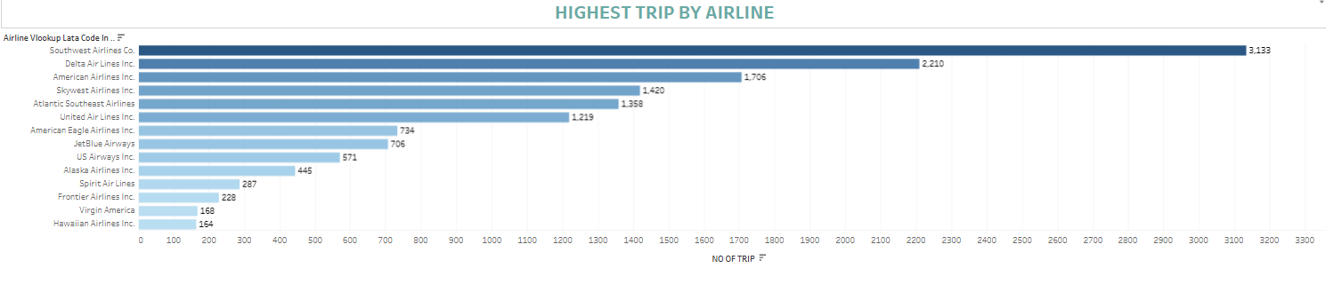
Description:
This chart shows
the highest no of trip by airline ,
the highest market share (southwest airline co)

Slide 7
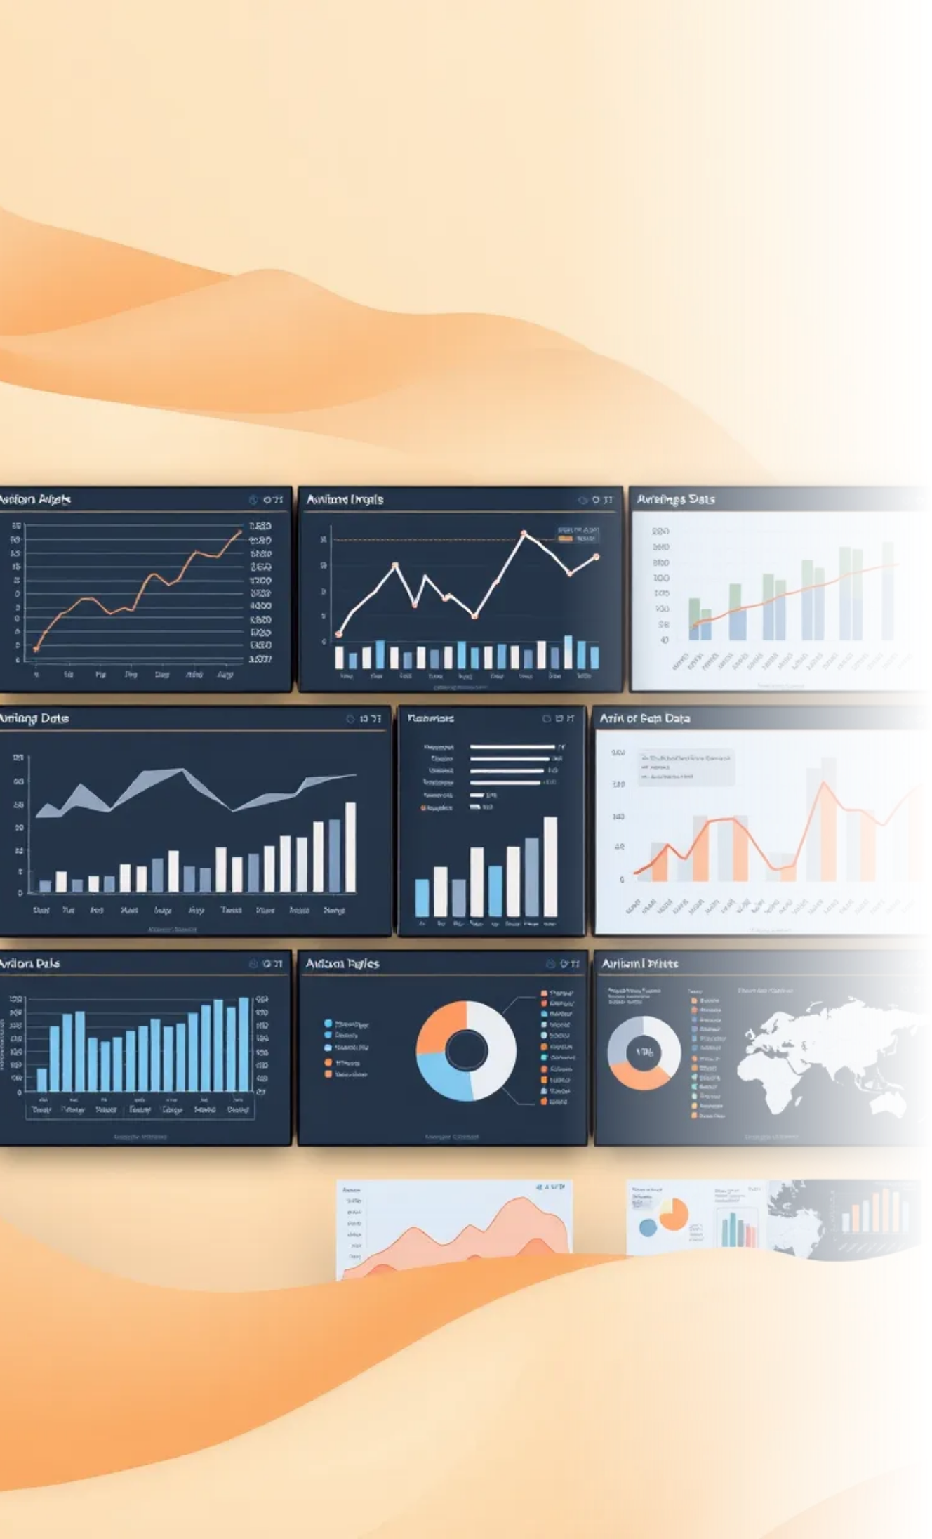
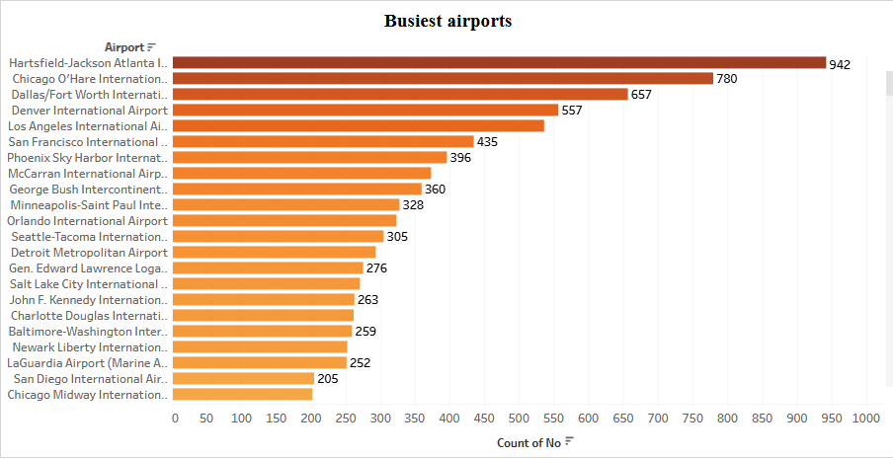
Description: This chart shows the top busiest airports based on the number of flights originating from them.

Slide 8
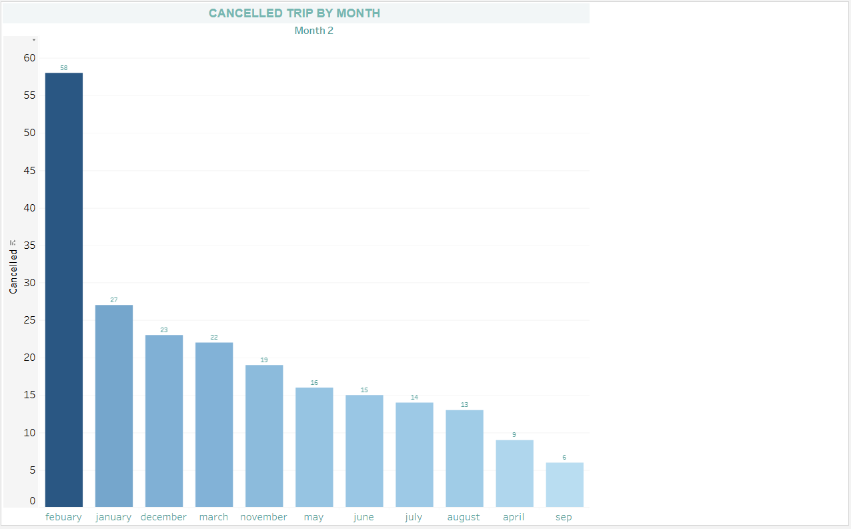
Description: This chart shows the number of cancelled flights each month (February highest month)

Slide 9
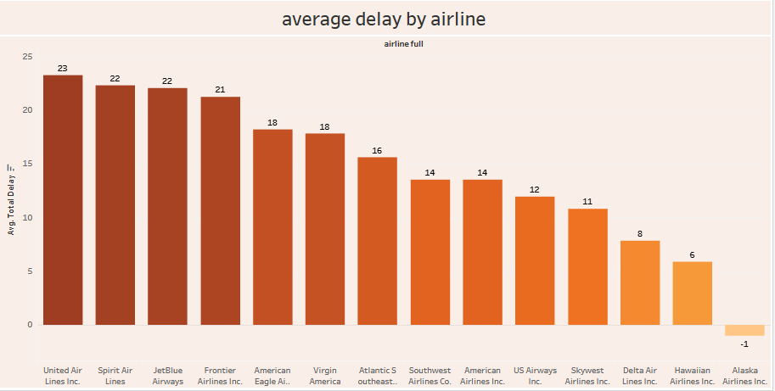
Description: This chart shows the average total delay by trip for each airline and the best airline(Alaska airline ).

Slide 10
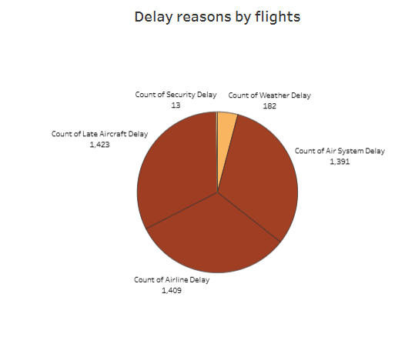
Description: This chart shows the No of light by different delay reason and show the security delay is the lowest reason of delay
And the most one late air craft delay.

Slide 11
https://public.tableau.com/authoring/finalahmedmagdy2/Dashboard1#1
https://public.tableau.com/authoring/finalahmedmagdy2/Dashboard2#1

